Slide 1
ICESat-2 data products
Ben Smith
ICESat-2 HackWeek 2020
6/8/2020

Slide 2
Outline
Information common to all data products
Timeline of data acquisition
ICESat-2 beams and spots
Orbital segments and file-naming conventions
A brief tour of data products
Land-ice products
Sea-ice products
Atmospheric products

Slide 3

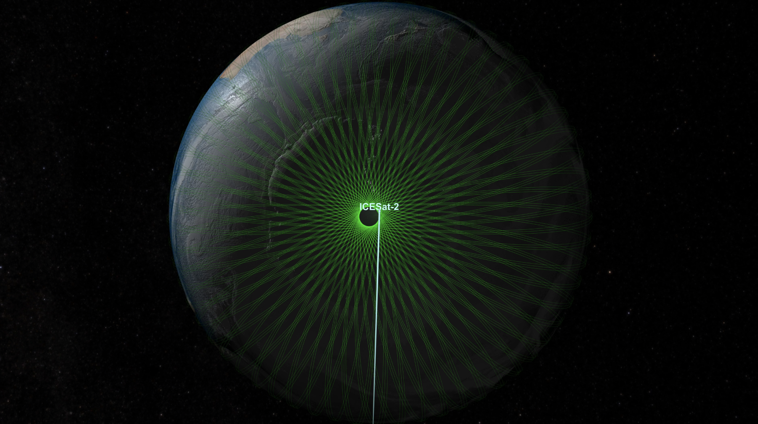
Orbit and Coverage
15 revs/day
1387 tracks
91-day revisit
Ground tracks at icesat-2.gsfc.nasa.gov

Slide 4
ICESat-2 data timeline
Cycle 1
Cycle 2
Cycle 3
Cycle 4
Cycle 5
Cycle 6
Cycle 7
2018
2019
2020
10/14
First data
4/4
Most recent data at NSIDC
4/1
First repeat-track data
6/26
Instrument
anomaly
7/26
Return to normal data collection
9/15
ICESat2 launched
Non-repeat orbits are available:
10/14/2018 to to 4/1/2019
Repeat-mode data are available:
3/1/2019 to 6/26/2019
7/26 2019 to present

Slide 5
Smith et al, 2019

Slide 6
Along and across-track coordinates
Along-track coordinates (x_rgt) are measured parallel to each reference ground track, starting at the equator, heading North:
0: First equator crossing
~ 6500 km: Southern Greenland, heading north
~10,000 km : Polehole North
~13,000 km : Southern Greenland, heading south
~27,000 km: Northern Antarctica, heading south
~30,000 km : Southern polehole
~33,000 km: Northern Antarctica heading north
Across-track coordinates (y_rgt) are measured perpendicular to the RGT, to the left:
Gt1x: +3200 m
Gt2x : ~0 m
Gt3x : -3200 m
N
Seg azimuth
P_{RGT}
y
RGT
x
P
RPT

Slide 7
ICESat-2 in its two orientations
Spot 6
Spot 4
Spot 2
Spot 1
Spot 3
Spot 5
Spot 5
Spot 3
Spot 1
Spot 2
Spot 4
Spot 6
Credit: NSIDC

Slide 8
General considerations for along-track products: regions
Credit: Kaitlin Harbeck

Slide 9
General considerations for along-track products: File-naming conventions
File names tell a lot about each product:
ATL06_20190916150733_12300405_003_01.h5
product
year
date
time
region
version
Reference ground track
Data release
cycle

Slide 10
Credit: NSIDC

Slide 11
ATL03- geolocated photons
AKA: The Big One
Contains
Latitude, longitude, and elevation for photons telemetered form ATLAS
Photon classifications for different surface types
Tides and atmospheric corrections
Instrumental parameters
Advantages:
Every photon is there, and every parameter
Disadvantages:
Same as advantages: This is a large and complex product
Use it if:
You want to understand where other products come from
You want to look at surfaces at a scale than that resolved on higher-level products
You have lots of storage space and lots of time

Slide 12
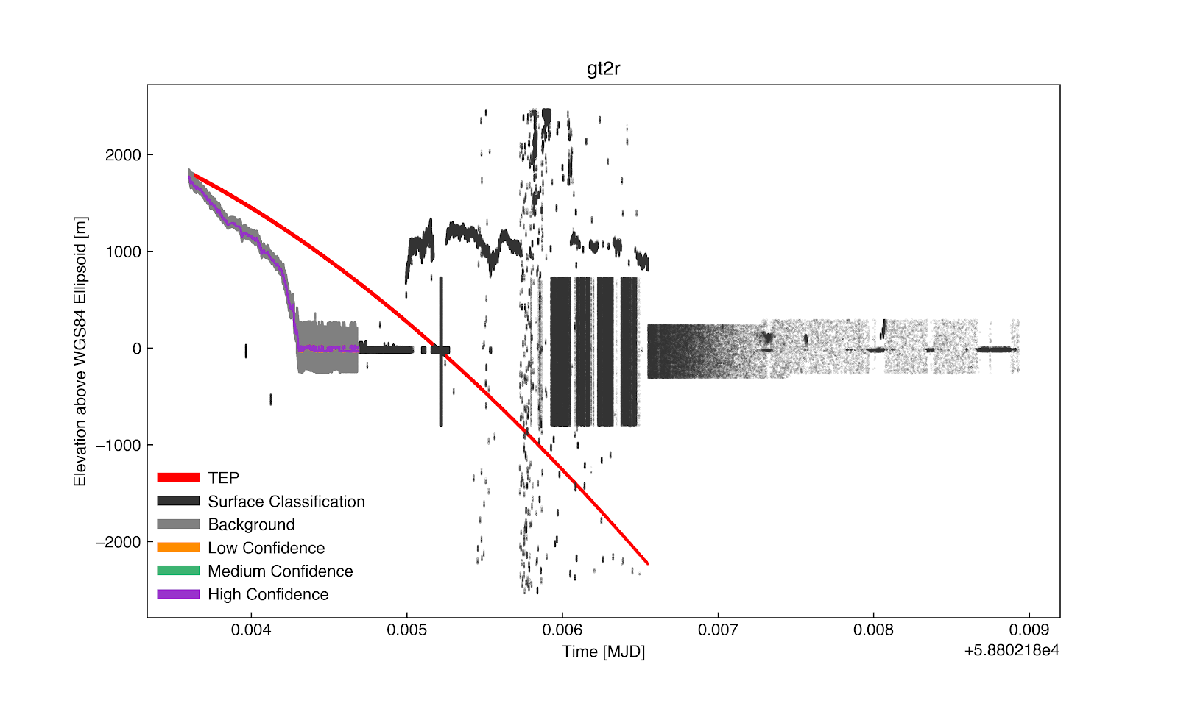
ATL03 example: Big, complex data

Slide 13
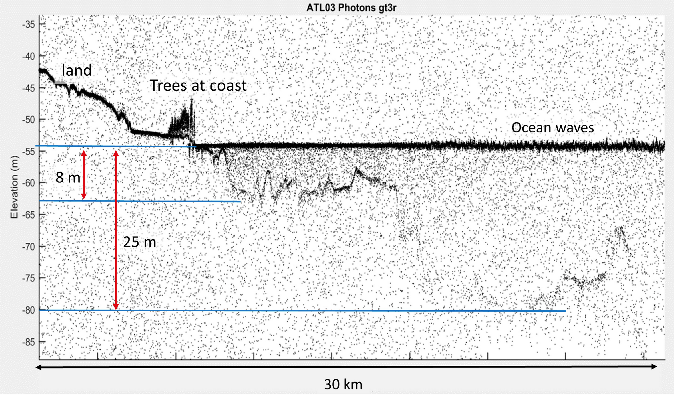
ATL03: Bathymetry
Credit: Parish et al, 2019

Slide 14
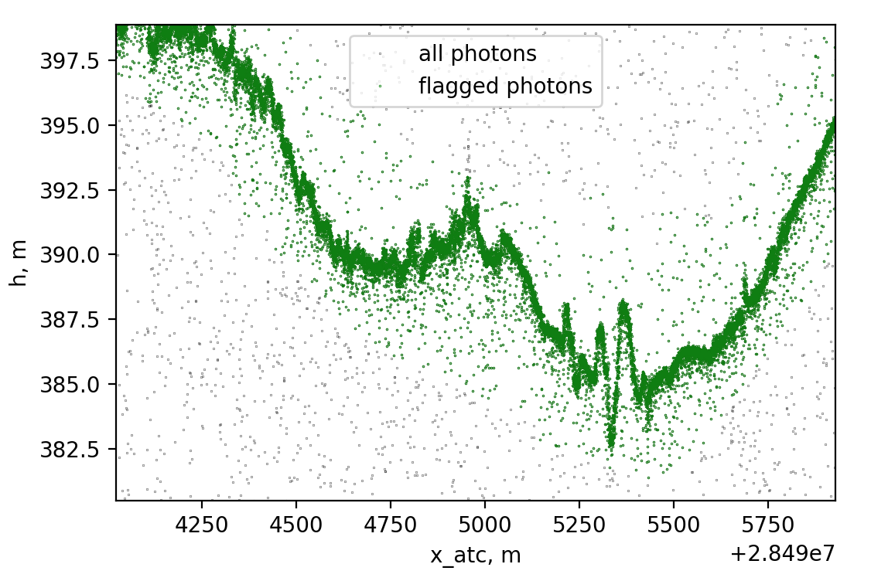
ATL03: Complex glacier surfaces

Slide 15
ATL06: Land-ice height
AKA: lots of little lines
Contains:
40-meter linear segments fit to land-ice photons (slopes and heights)
Error estimates
Tides and instrumental corrections
Segment quality parameters
Advantages:
Lighter product than ATL03
Provides surface heights (not just photon heights)
Provides repeatable parameters (can be compared from cycle to cycle)
Disadvantages:
40-m resolution is too coarse for some applications (crevasses, bare rock)
40-m resolution is too fine for some large-scale studies
Use it if:
You want to make large-scale repeatable measurements of glaciers

Slide 16
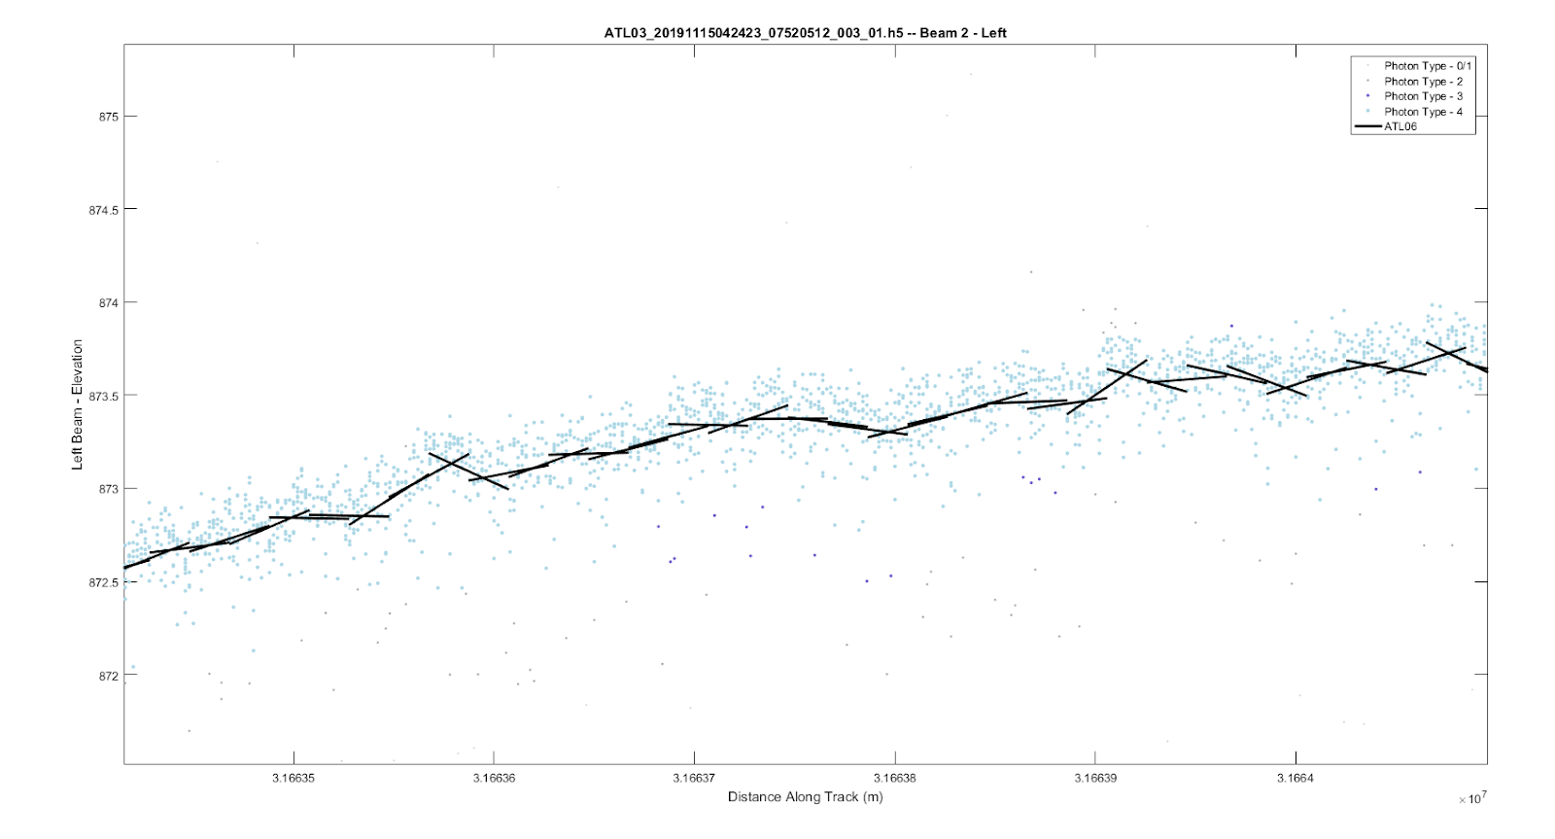
ATL06 example: along-track slopes
Credit: Holschuh / Sutterley

Slide 17

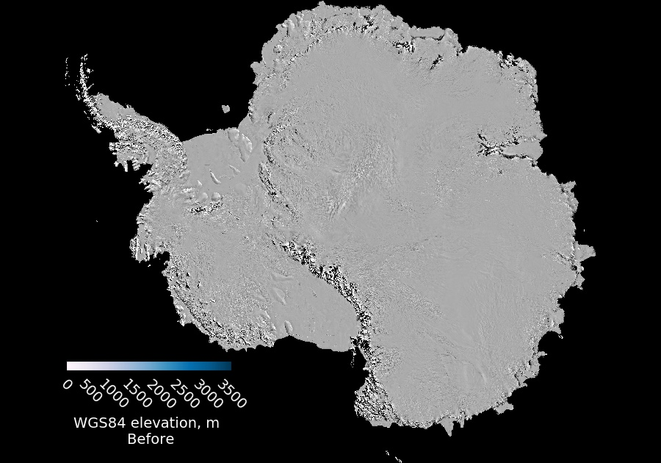
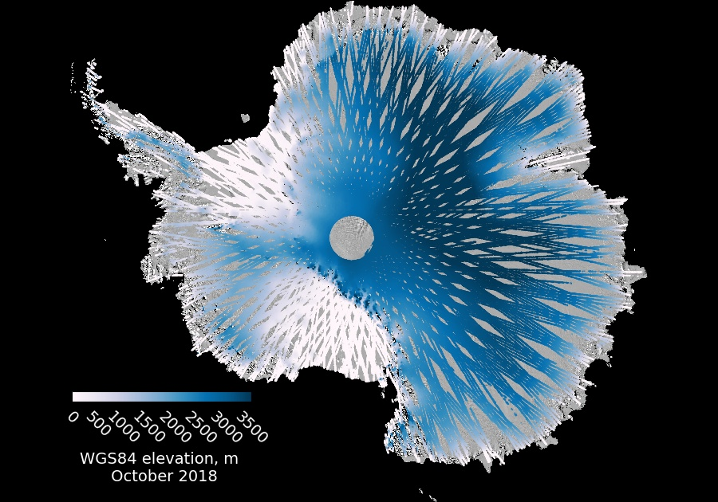
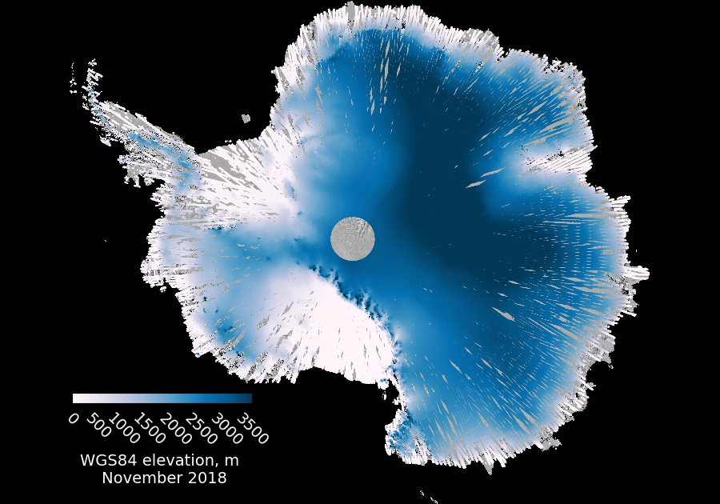
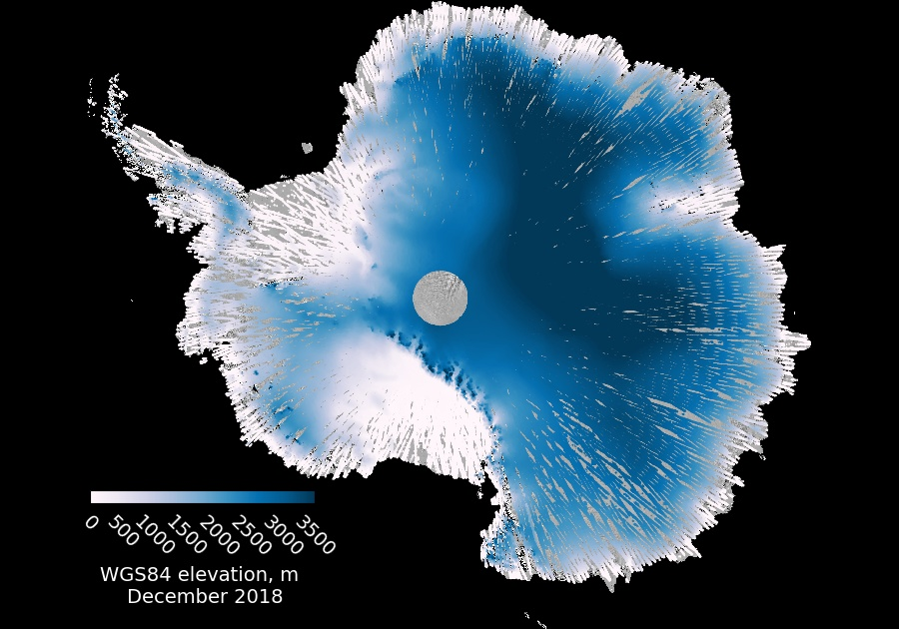
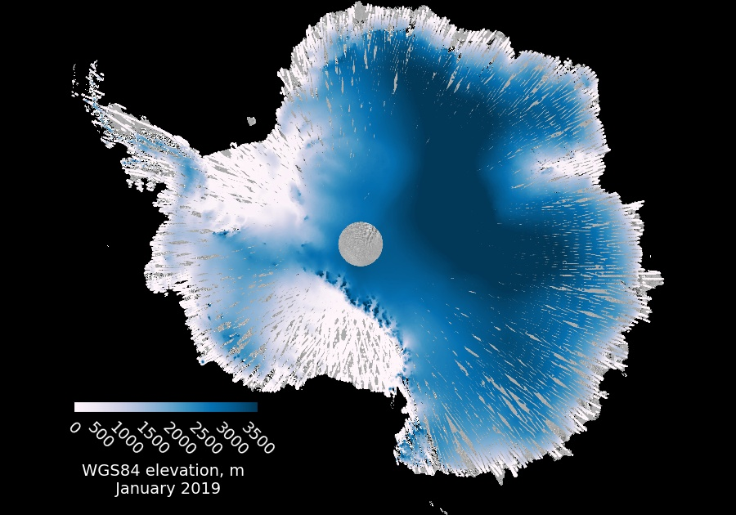
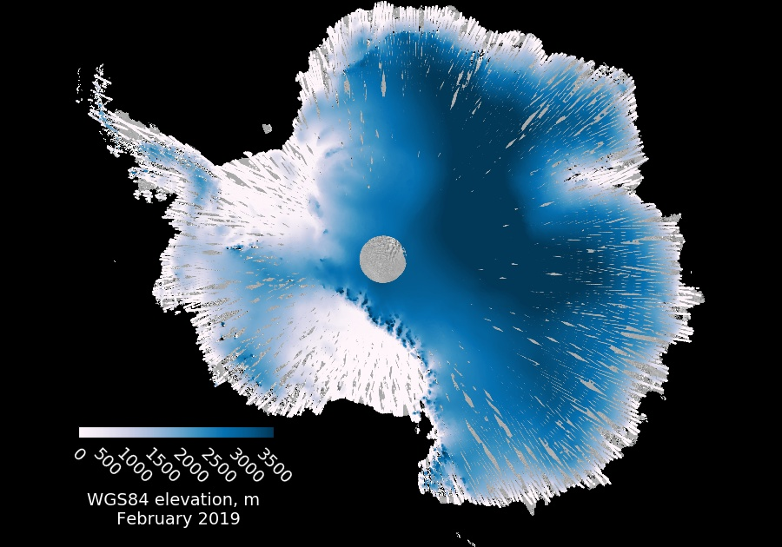


ATL06: Mapping the ice sheets in a soothing blue haze

Slide 18
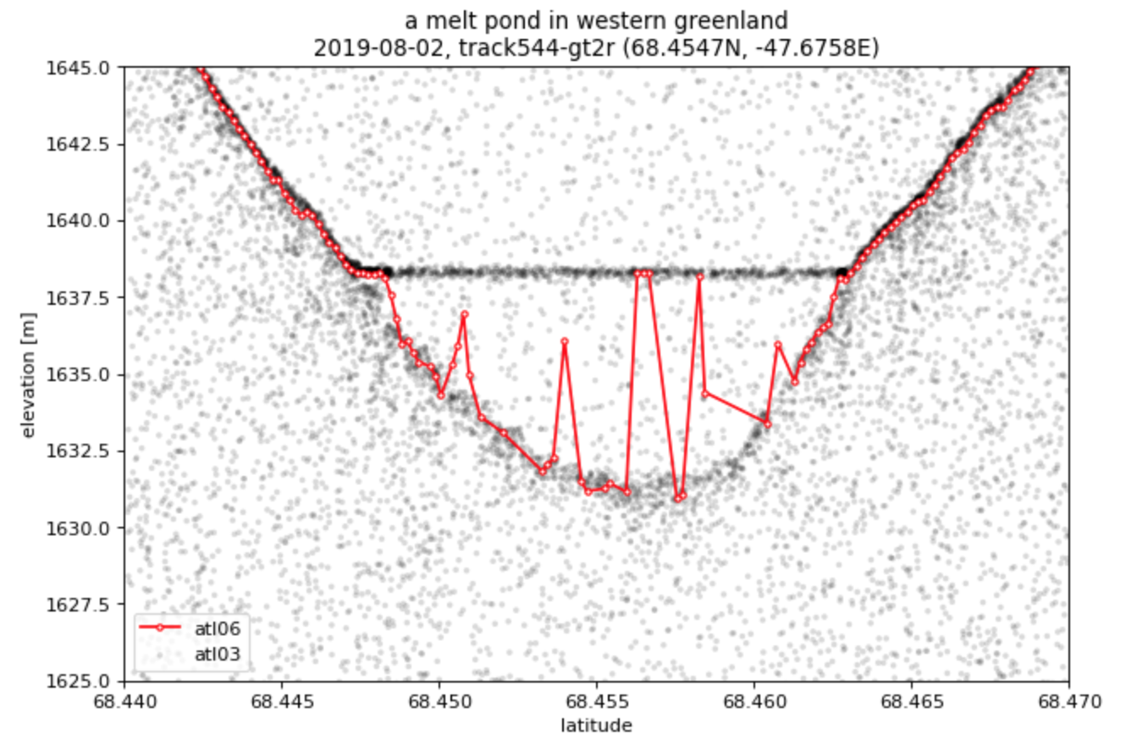
ATL06 example: problems with surface water in Greenland
Credit: Philipp Arndt

Slide 19
ATL11: Land-ice H(t) [Future product]
AKA: Like ATL06, but easier
Provides:
Repeat measurements of glacier surfaces, corrected for across-track displacements, accumulated over reference tracks
Quality and error assessments
Advantages:
Brings together multiple repeats of ATL06, removes signals that are not related to elevation change
Smaller, easier-to-use product than ATL06
Disadvantages:
Loss of detail relative to ATL06 (fewer paramters)
May not work well over very complex surfaces
Not yet released (should be available through NSIDC later this summer)
Use it if:
You want to measure large-scale glacier change

Slide 20
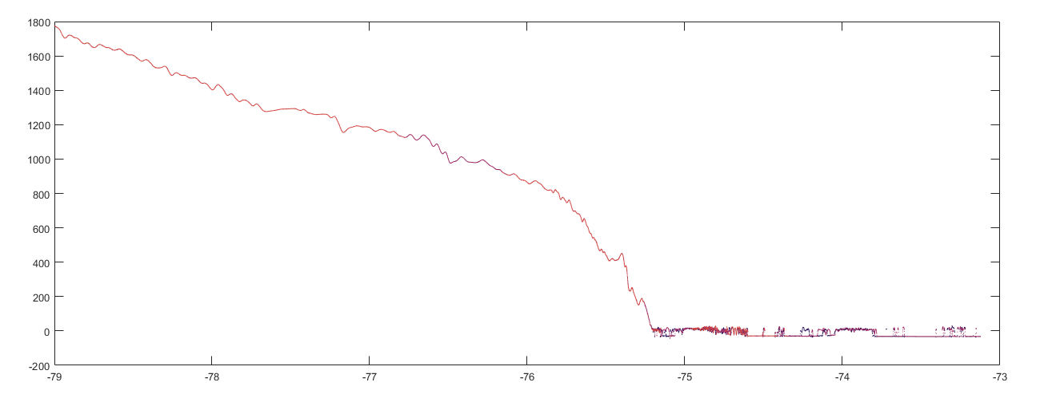
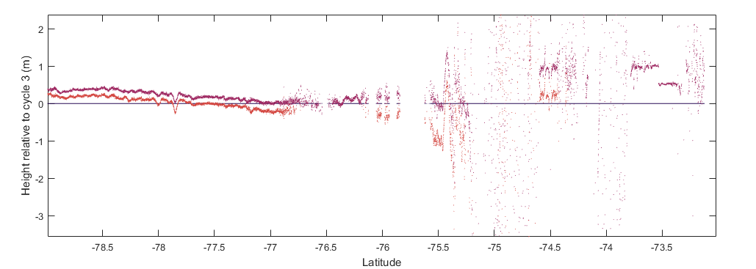
ATL11 example: Elevation and elevation change
Credit: Holschuh / Sutterley

Slide 21
ATL11: Mapping elevation change
Q2 2019 -> Q3 2019
Q3 2019 -> Q4 2019
Q4 2019 -> Q1 2020
Q1 2020 -> Q2 2020

Slide 22
ATL14/15: land ice DEM and elevation change
AKA: The pretty picture of the ice sheet
Provides:
Gridded DEM and elevation-change estimates
Advantages:
Brings together repeat measurements from different tracks to map surface-height changes
Disadvantages:
Not released yet
Use it if:
You are living in the future

Slide 23
ATL08: Land/water vegetation elevation
AKA: The salad course
Provides:
Alternate surface-detection methods
Advantages:
Can sometimes detect the surface in complex terrain better than ATL06
Does a better job of handling multiple returns (e.g. from lake bottoms)
Disadvantages:
Can produce unpredictable results over sloping surfaces
Use it if:
You need to detect multiple surfaces
You want to measure elevations of land around glaciers
You are looking at vegetated terrain

Slide 24
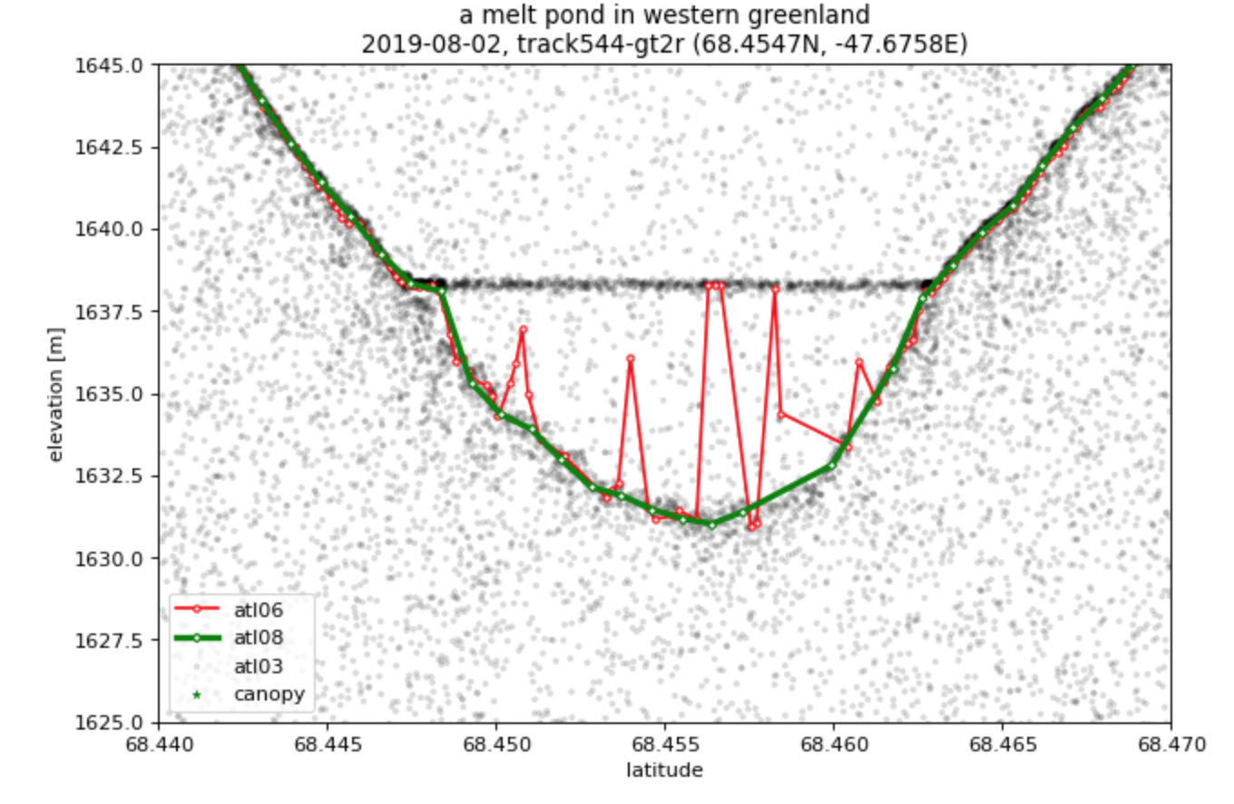
ATL08 example
Credit: Philipp Arndt

Slide 25
ATL07: Sea-ice height
AKA: ATL06’s cousin
Provides:
Along-track sea surface and sea ice height and type
Each segment is an aggregate of 150 photons, segment length varies
Advantages:
Adaptive length scale allows for resolving the sea surface in leads
Includes a lot of surface statistics
Lighter product than ATL03
Disadvantages:
Only calculated where sea ice concentration is > 15%
Loses resolution of small-scale features
Height statistics must be weighted by variable segment lengths
Surface type classification less accurate in summer on a melting sea ice surface
Use it if:
You are doing any kind of sea ice study!

Slide 26
ATL10: Sea-ice freeboard
AKA: ATL07 plus some math
Provides:
Along-track sea ice freeboard (height of the sea ice above local sea surface)
Calculated in 10 km segments if that segment contains a sea surface reference
Advantages:
High spatial resolution and wide coverage
Disadvantages:
Same variable length scale as ATL07
Only provided where sea ice concentration > 50% and 50 km from coast
Freeboard near ice edge affected by sea state- scattering in troughs of waves result in low sea surface and anomalously high freeboard
Use it if:
You are doing Artic-wide studies or are focused on consolidated ice regions
You want to calculate sea ice thickness

Slide 27
ATL07 and ATL10 example:
Credit: Ellen Buckley

Slide 28
ATL04/09: Calibrated backscatter / Atmospheric characteristics
AKA: Cloud-o-grams
Provides:
Profiles of atmospheric backscatter
Layer heights and optical properties
Advantages:
Shows global cloud properties
Disadvantages:
Complicated product
Not presented in the same along-track coordinates as along-track products
Use it if:
You want to know why you can’t see the ground
You want to understand atmospheric effects on surface products
You’re interested in clouds

Slide 29
ATL09 example
Credit: NSIDC

Slide 30
Where to learn more:
The ICESat-2 webpage (https://icesat-2.gsfc.nasa.gov):
Links to the Algorithm Theotretical Basis Documents:
KMLs of ground-track locations (under Tech Specs)
Animations
The NSIDC landing page (https://nsidc.org/data/icesat-2):
Product format descriptions
Data file naming conventions
News on data releases
Known issue descriptions
Data(!)

